Slide 1

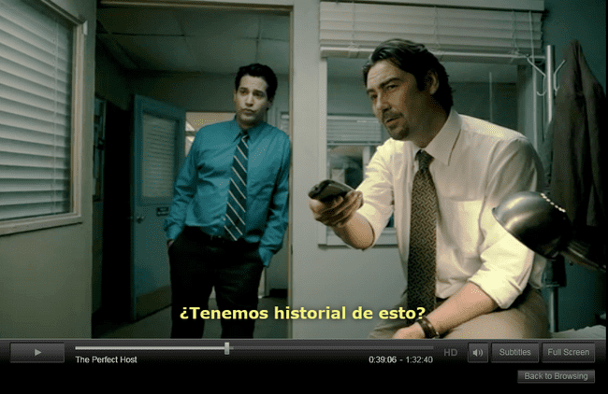
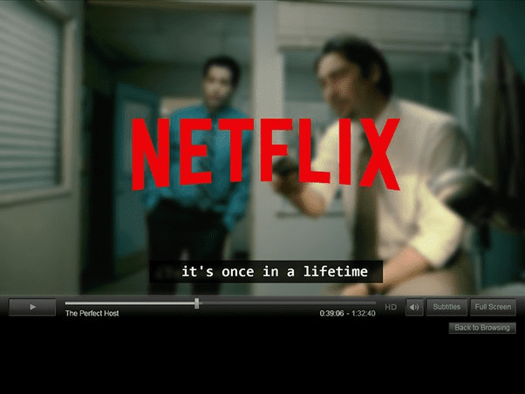
BeyondBorders AI

Slide 2
BeyondBorders AI
Bringing Worlds Together…
…One Frame at a Time.

Slide 3
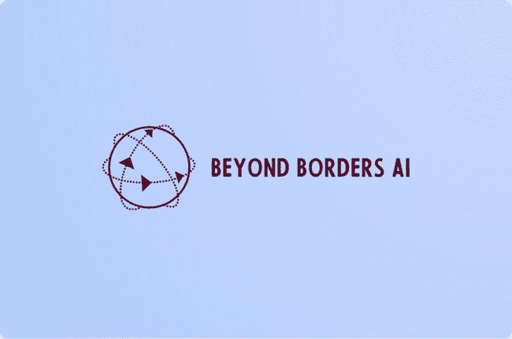

Slide 5

Beyond Borders AI
Bringing Worlds Together, One Frame at a Time.

Slide 6

Notes:
As the global film industry predominantly speaks the language of Hollywood, many are left on the sidelines, unable to fully immerse themselves in the cinematic experience.

Slide 7
Beyond Borders AI
Bringing Worlds Together, One Frame at a Time.

Slide 11
BeyondBorders AI

Slide 13
Notes:
In a world where the magic of cinema knows no borders… there is a silent struggle - language barrier which

Slide 14

Problem
85%
Parents said watching TV together help them start conversations with their kids.
…but most of the content children watch these days is in a language parents don’t understand.
Notes:
In a world where the magic of cinema knows no borders… there is a silent struggle - language barrier which

Slide 15

Notes:
In a world where the magic of cinema knows no borders… [have the images appear one by one, overlapping eachother]

Slide 16

Notes:
In a world where the magic of cinema knows no borders… [have the images appear one by one, overlapping eachother]

Slide 17
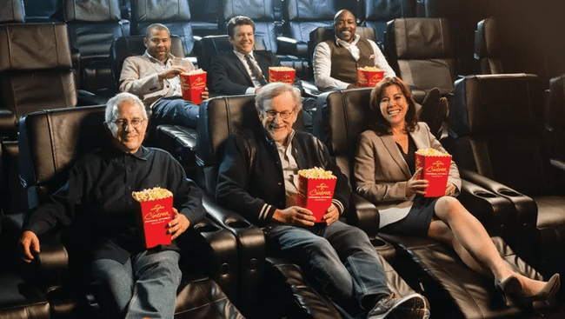
Notes:
In a world where the magic of cinema knows no borders… [have the images appear one by one, overlapping eachother]

Slide 18

Notes:
In a world where the magic of cinema knows no borders… [have the images appear one by one, overlapping eachother]

Slide 19

Notes:
In a world where the magic of cinema knows no borders… [have the images appear one by one, overlapping eachother]

Slide 20

Notes:
there's a silent struggle that millions face - the language barrier

Slide 21

Notes:
there's a silent struggle that millions face - the language barrier

Slide 22

Notes:
As the global film industry predominantly speaks the language of Hollywood, many are left on the sidelines, unable to fully immerse themselves in the cinematic experience.

Slide 23

Notes:
As the global film industry predominantly speaks the language of Hollywood, many are left on the sidelines, unable to fully immerse themselves in the cinematic experience.

Slide 24

Notes:
As the global film industry predominantly speaks the language of Hollywood, many are left on the sidelines, unable to fully immerse themselves in the cinematic experience.

Slide 25
Notes:
As the global film industry predominantly speaks the language of Hollywood, many are left on the sidelines, unable to fully immerse themselves in the cinematic experience.

Slide 26

Notes:
As the global film industry predominantly speaks the language of Hollywood, many are left on the sidelines [transition to next slide for contrast]

Slide 27

Notes:
…unable to fully immerse themselves in the cinematic experience.

Slide 28

Notes:
Subtitles can only do so much, especially because the cost and time associated with translating and dubbing films are barriers in themselves.

Slide 29
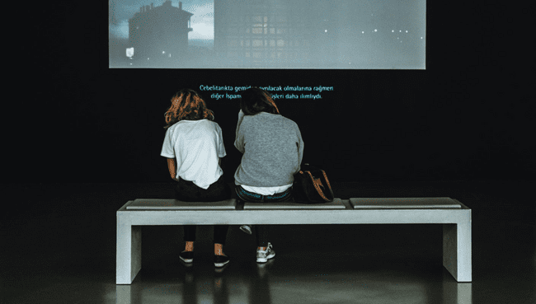
Notes:
Subtitles can only do so much, especially because the cost and time associated with translating and dubbing films are barriers in themselves.

Slide 30

Notes:
Subtitles can only do so much, especially because the cost and time associated with translating and dubbing films are barriers in themselves.

Slide 32
Notes:
Subtitles can only do so much, especially because the cost and time associated with translating and dubbing films are barriers in themselves.

Slide 33

Notes:
But what if there was a way to break down these language barriers?

Slide 34

Notes:
But what if there was a way to break down these language barriers?

Slide 35

Notes:
But what if there was a way to break down these language barriers?

Slide 36
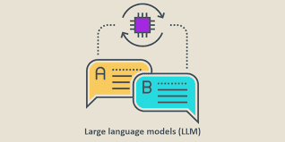
Implementation: BeyondBorders AI
Trains and translates and the user hears the same voice but translated in their language of choice!
Send audio to the model

Slide 37
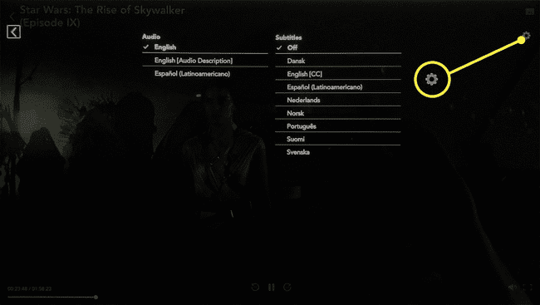
Implementation: User
User selects their language of choice
And can start watching!

Slide 38
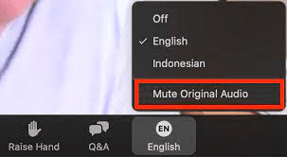
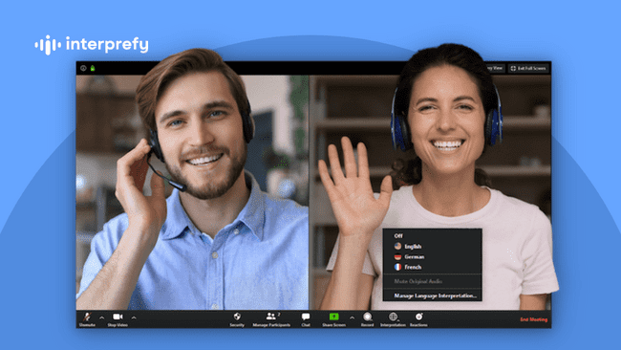
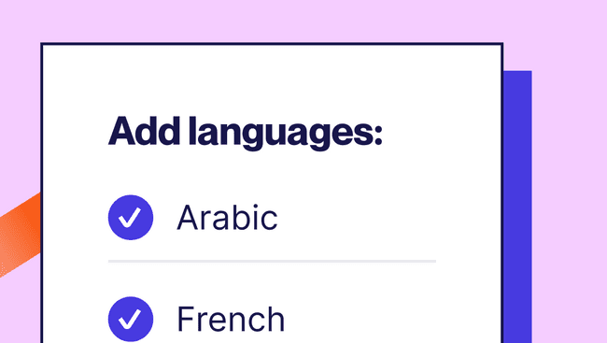
PRODUCT NAME
Notes:
Introducing [PRODUCT_NAME] - revolutionizing the way we watch movies.

Slide 40

PRODUCT NAME
Notes:
Introducing [PRODUCT_NAME] - revolutionizing the way we watch movies.

Slide 41

PRODUCT NAME
Notes:
Introducing [PRODUCT_NAME] - revolutionizing the way we watch movies.

Slide 42
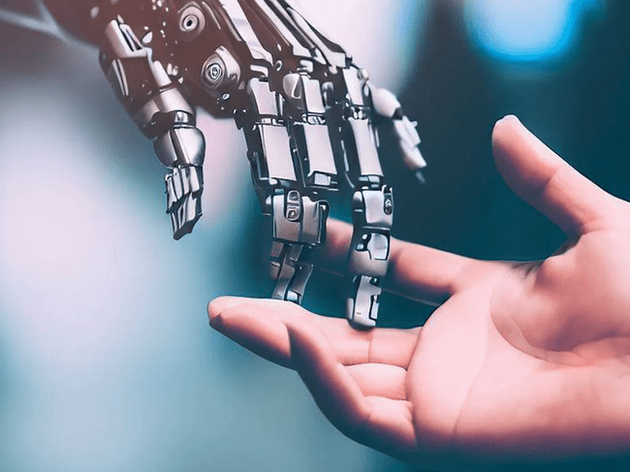
Notes:
We're leveraging the power of artificial intelligence to make movies accessible to people of diverse backgrounds.

Slide 43

Notes:
We're leveraging the power of artificial intelligence to make movies accessible to people of diverse backgrounds.

Slide 44

Notes:
We're leveraging the power of artificial intelligence to make movies accessible to people of diverse backgrounds.

Slide 45







Slide 46
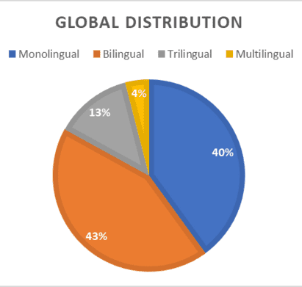
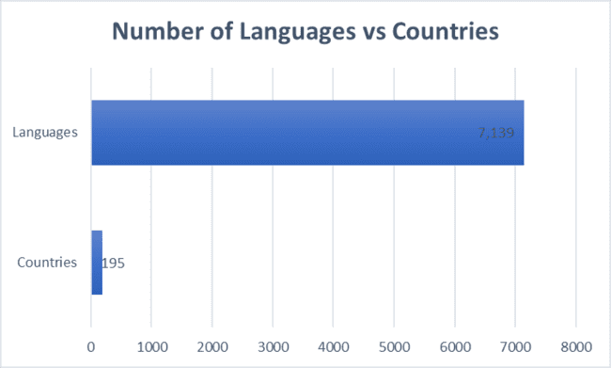
How big is the language barrier?

Slide 47

AI Translation Dubbing Market
Market size: 2.5 Billion USD, growing at 7.8% until 2028
Increased demand for video content localisation
Geographical forecast: North America has greatest Market share
Asia Pacific has the fastest growth

Slide 48


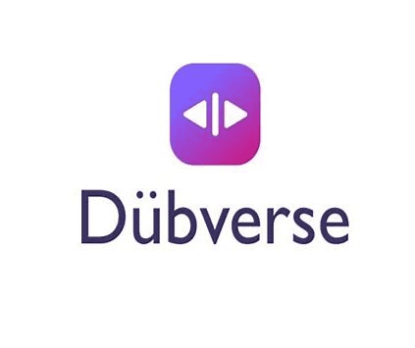




Competition
1.Speechify
2.Dubverse
3.Elai
4.Rask
5.Hai
But none of these do the translation and dubbing real time.
EZ dub- Y combinator startup with real time AI translation and dubbing. Limited to 5 min videos and shorter. Not live yet.
Therefore we must be fast and first to market.

Slide 49

Opportunities
Real time AI translation and Dub
Could integrate Confluent’s recently released real time data streaming for AI capabilities.
Branding could include connecting humans and ease of use as a theme to differentiate from competitors and a home use case instead of content creator.

Slide 50

Market Strategy
Two implementations:
Enterprise integration: to partner with current video streaming, video conferencing use cases
Potential Partners: OTT streaming (Netflix, Prime, Hulu, etc.), Youtube, Gaming (Twitch, Discord), Video conferencing, Government
Chrome extension: available to users who want to use dubbing translation on any video content. Could start with this

Slide 51
Possible Solution Architecture
Voice Separation and Isolation
Spleeter by Deezer
Speech Recognition
Mozilla DeepSpeech
Translation
OpenNMT or Marian NMT
Video Ingest
Final Video
Combining dubbed audio with video
AWS
Voice Synthesis & Dubbing
Mozilla TTS or ESPnet
Notes:
While Syona Explained the implementation, here is the detailed solution architecture that we’re currently planning to implement. First, we will ingest Video using APIs, depending on the source of video, the APIs will differ. To separate voice from background music, we will use splitter which is an open source model. The next part is To convert spoken English words into text, speech recognition for which we will use Mozilla Deepspeech. To translate English text to language of choice, we will use openNMT ot Marian NMT models. To synthesize the translation in the original actor’s voice, we will use Mozilla TTS. And for bringing it all together, we’re planning to use AWS. This is a tentative implementation plan and we will change if there is better accuracy in other models.
Voice Separation and Isolation (Spleeter by Deezer)
Cost: Free to use. Spleeter is an open-source tool, but you will need computing resources to run it, which could incur costs depending on your setup.
1. Speech Recognition
Model: Mozilla DeepSpeech
Description: An open-source Speech-to-Text engine based on Baidu's Deep Speech research paper. It uses machine learning techniques to convert speech to text.
Cost: Free, but requires computing resources for training and running the model.
2. Translation
Model: OpenNMT or Marian NMT
OpenNMT Description: An open-source neural machine translation framework, supporting training and deployment of models.
Marian NMT Description: An efficient, free Neural Machine Translation framework mainly developed by the Microsoft Translator team.
Cost: Free, but as with speech recognition, you'll need resources for training and running the models.
3. Voice Synthesis
Model: Mozilla TTS or ESPnet
Mozilla TTS Description: An open-source text-to-speech synthesis system designed for use in real-time applications.
ESPnet Description: An end-to-end speech processing toolkit, capable of voice synthesis, among other functionalities.
Cost: Free to use, but again, computing resources are needed for training and deploying the models.

Slide 52
Implementation: BeyondBorders AI
Trains and translates and the user hears the same voice but translated in their language of choice!
Send audio to the model

Slide 53
Implementation: User
User selects their language of choice
And can start watching!

Slide 54
Implementation

Slide 55
Implementation
Trains and translates and the user hears the same voice but translated in their language of their choice!
Send audio to the model

Slide 56

Team Capability
Business strategy: Lalitha Bhupalam
Finance and Accounting: Bijay Gautam
Marketing: Dhanashree Ingle
Engineering and Technology: Syona Mehra and Francine Go
Lalitha, Bijay and Dhanashree can also contribute in Engineering due to ML experience.

Slide 59




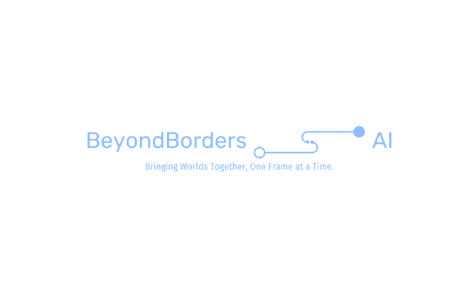

Slide 60
Beyond Borders AI
Bringing Worlds Together, One Frame at a Time.
Syona Mehra, Bijay Gautam, Dhanashree Badhe, Lalitha Bhupalam, Francine Go

